Slide 1

Aircraft Boarding Strategies Using Discrete Event Simulation
David Gyaraki: 582340 Lavin Pallas: 581619 Julius de Clercq: 582360

Slide 2
System description
Aircraft consists of 30 rows ,6 seats per row
Front boarding only
Passengers cannot pass each other , no back tracking
Every passenger needs to stand up for another passenger whose seat is in the same row
Aisle cell can fit more than one person at the same time to allow passengers to reach their seat
Passengers are assumed to be aware of their seat number and cannot change it
There is assumed to be sufficient luggage for each passenger

Slide 3
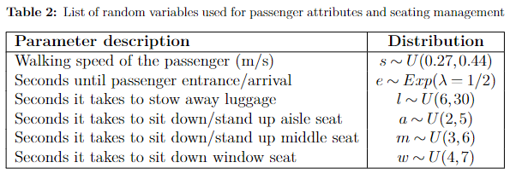

Slide 4
Aircraft boarding system

Slide 5
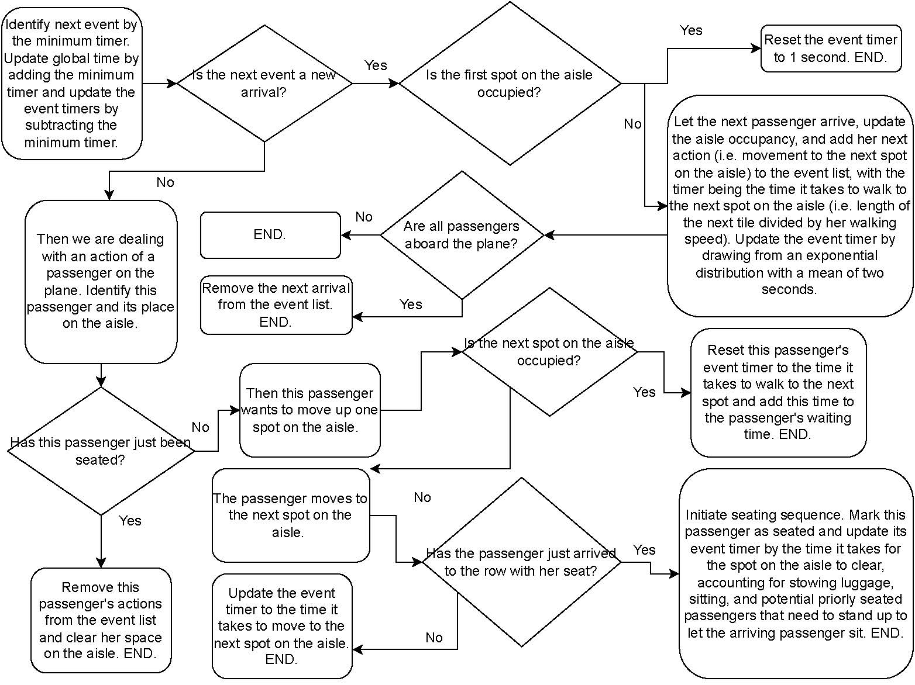

Slide 6
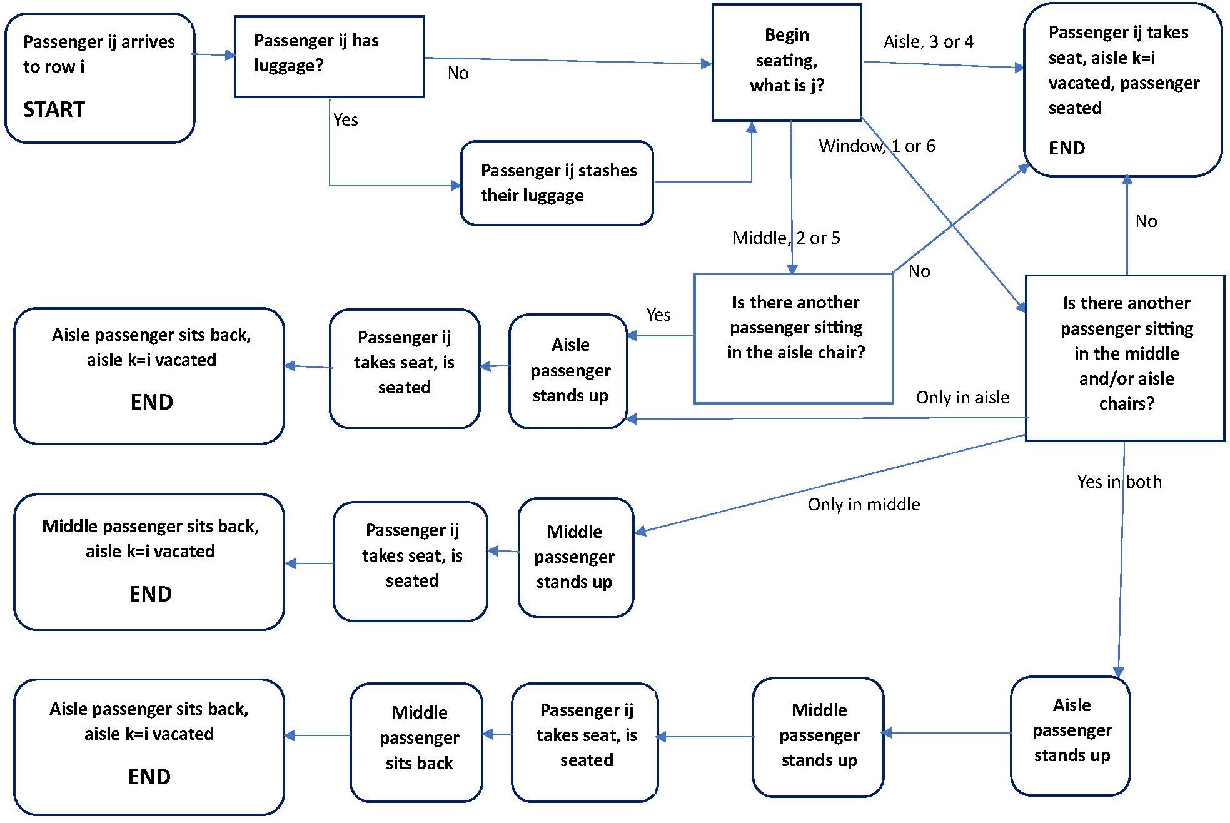

Slide 7
Boarding procedure snapshots for each boarding strategy

Slide 8
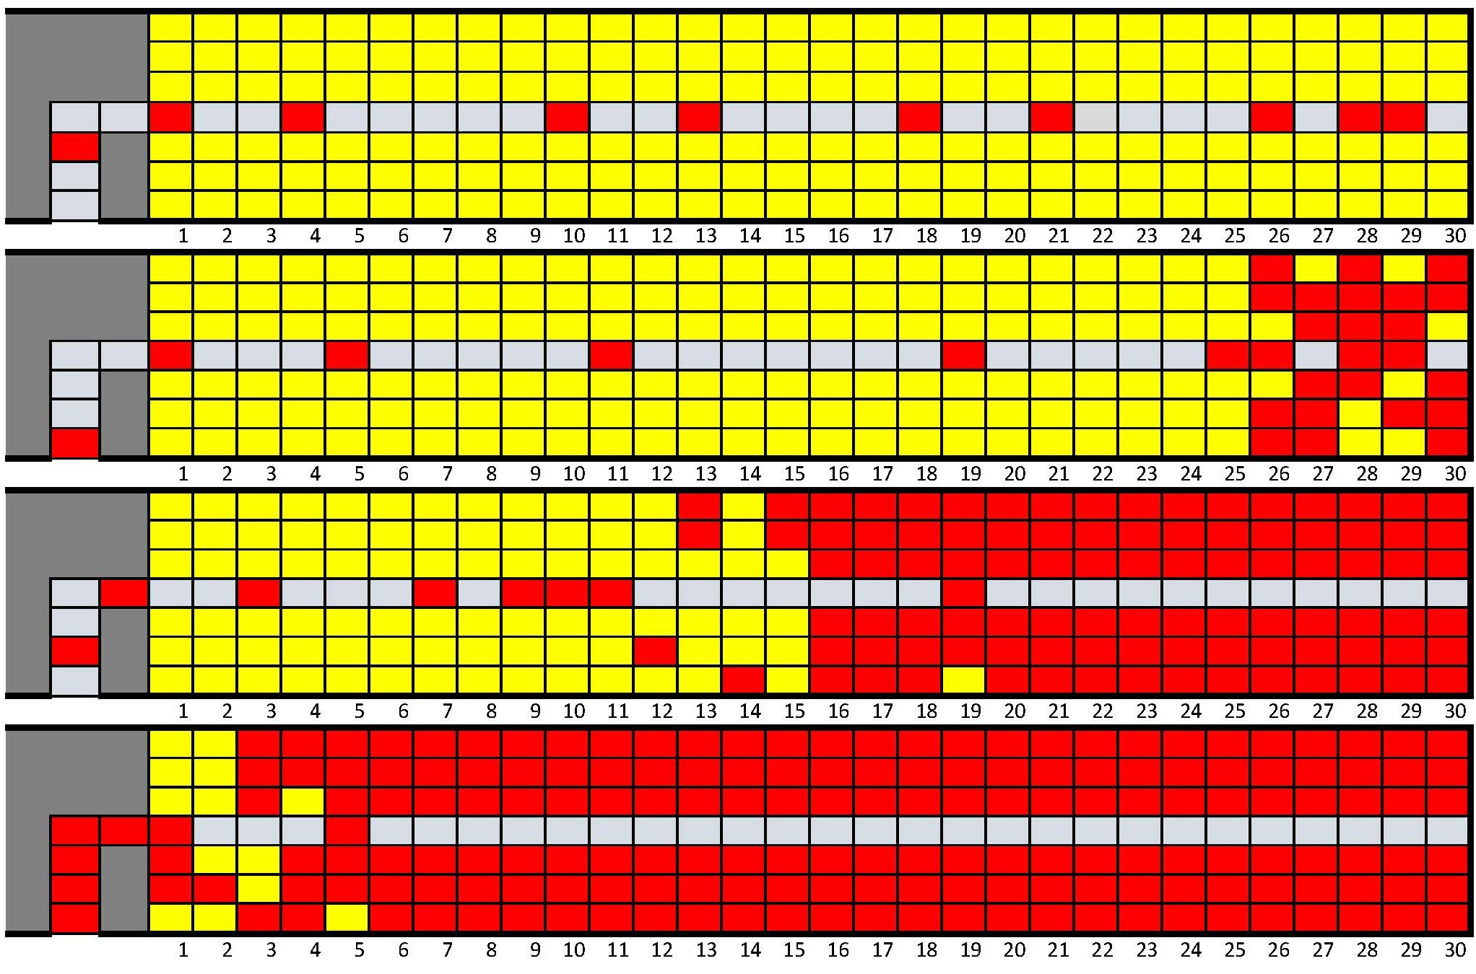
Back to front strategy

Slide 9
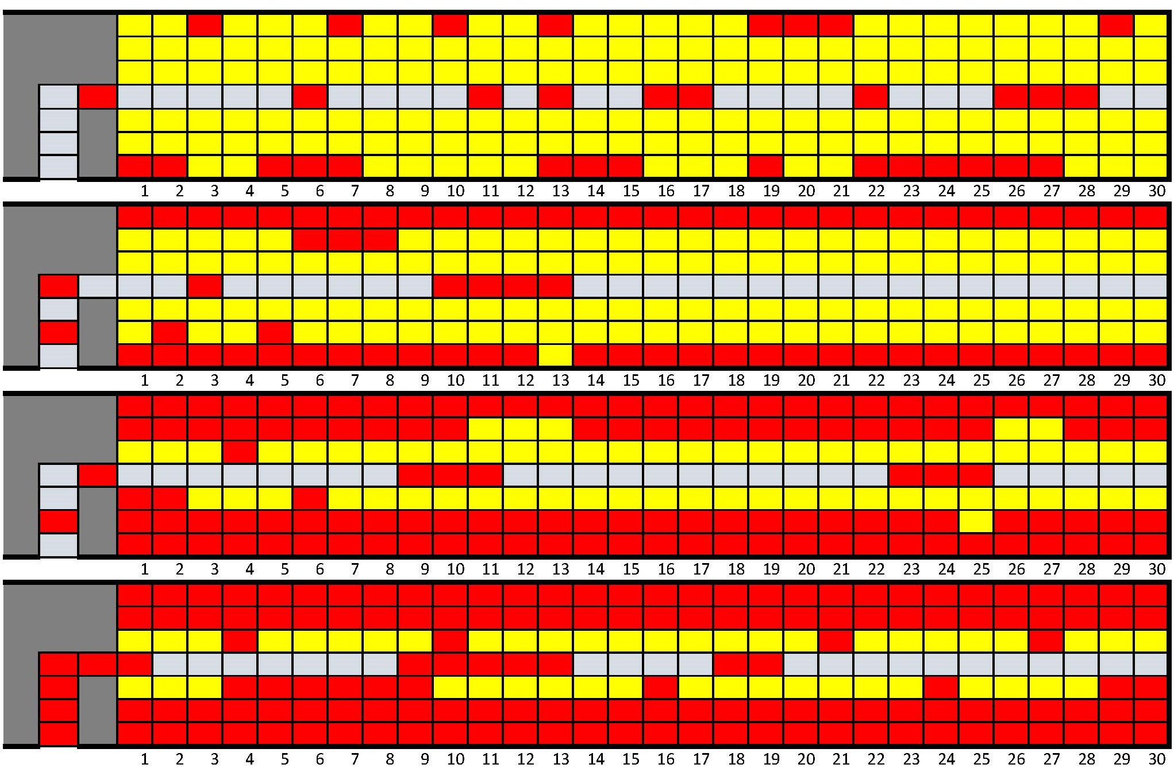
Window middle aisle strategy

Slide 10
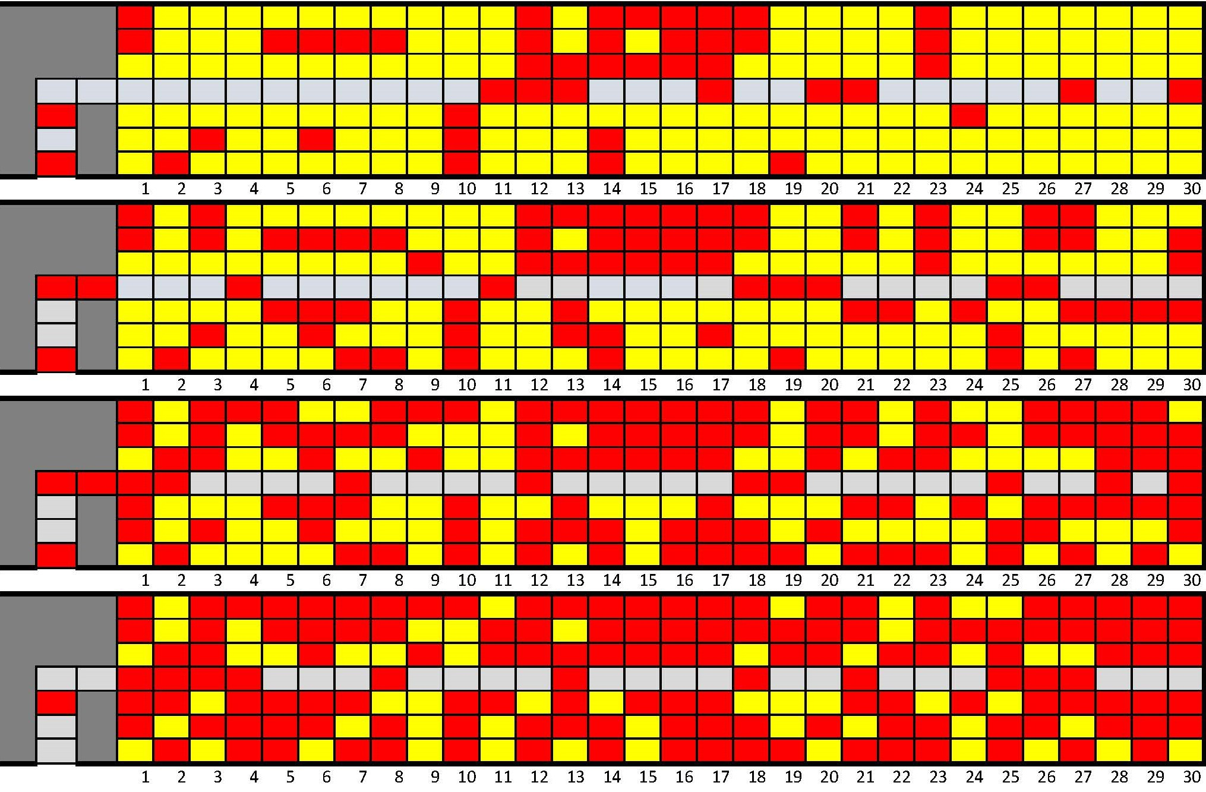
Random strategy

Slide 11
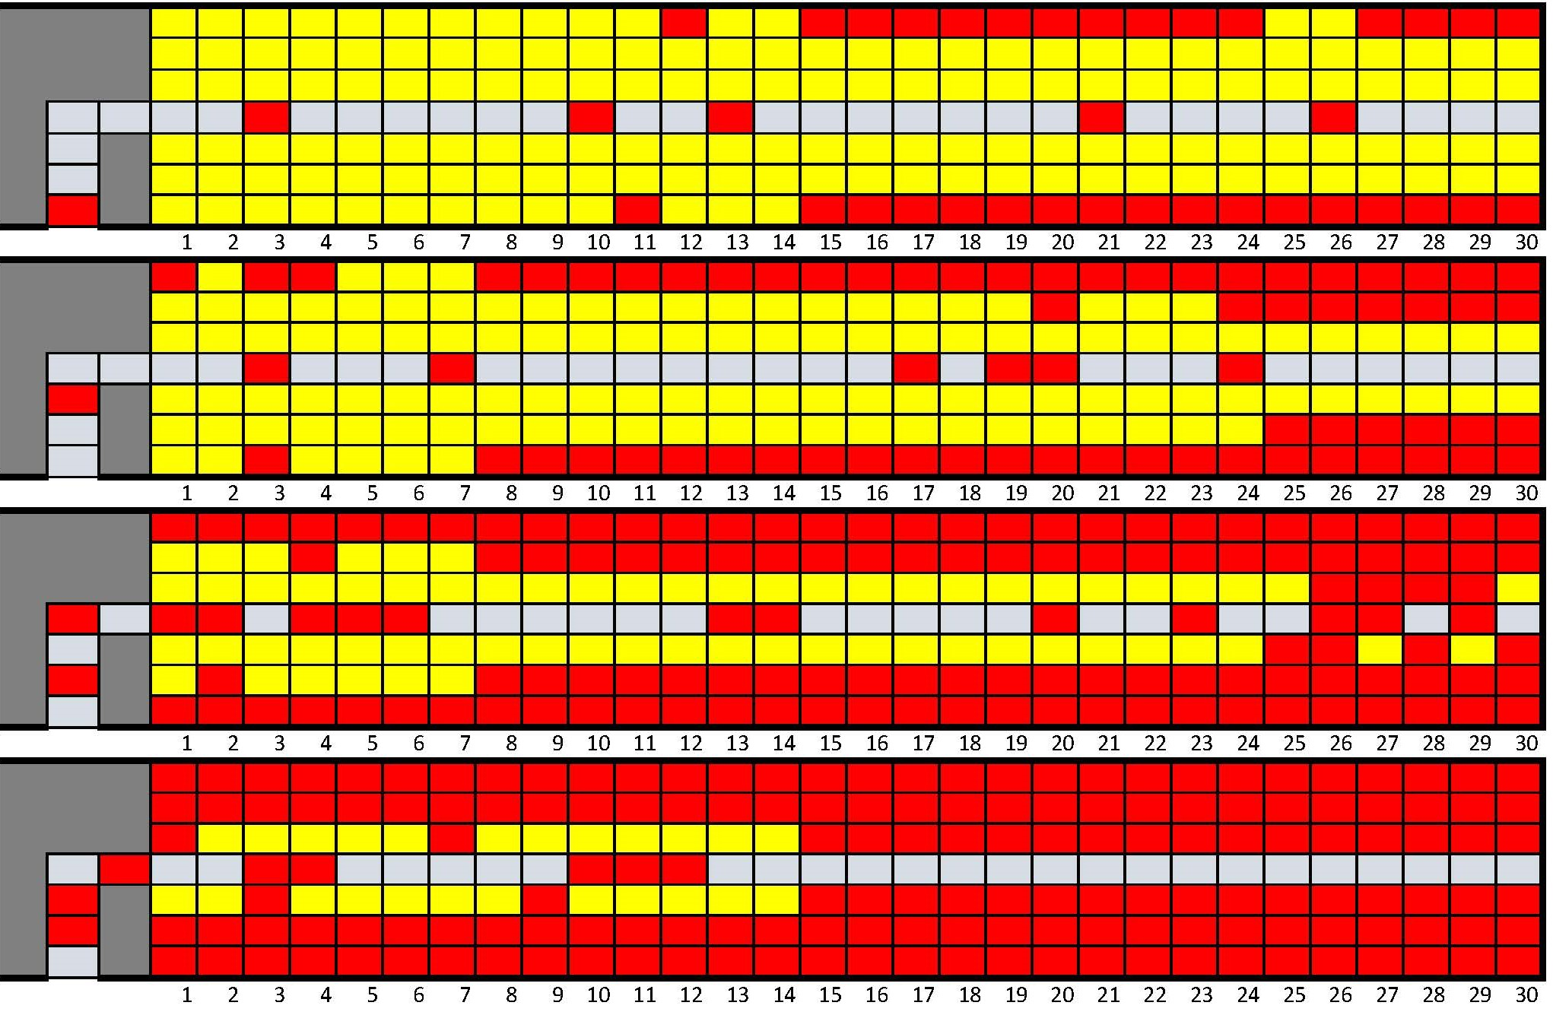
Reverse pyramid strategy

Slide 12
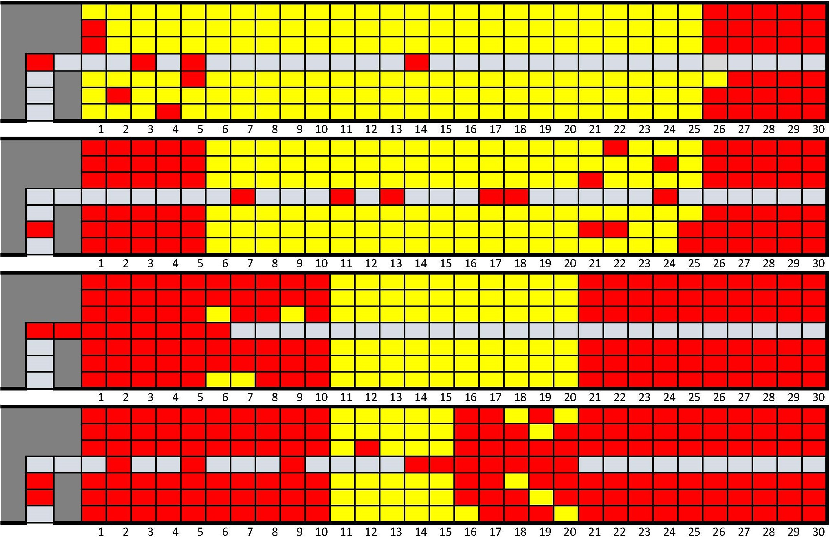
Rotating zone strategy

Slide 13
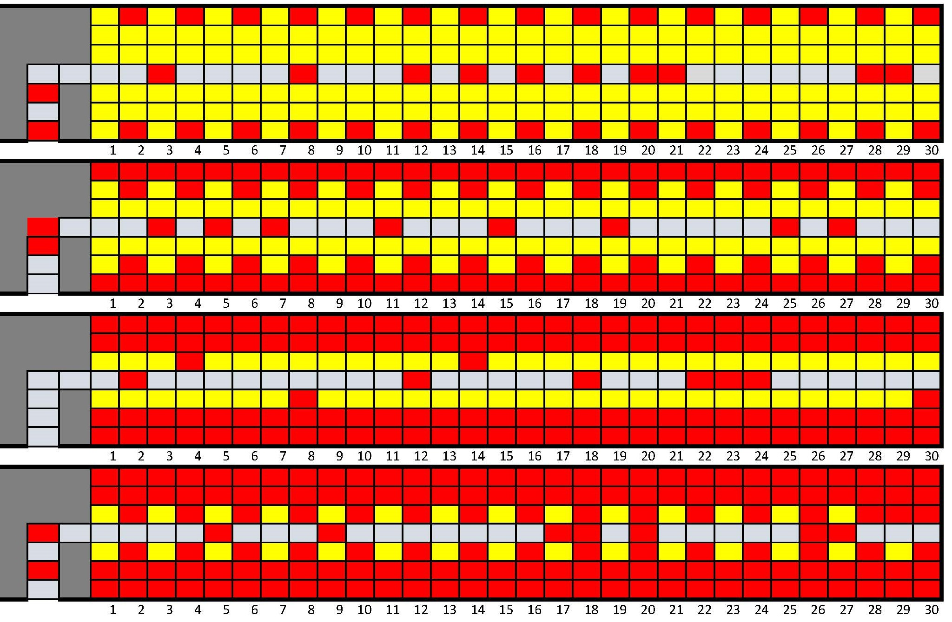
Optimal strategy

Slide 14
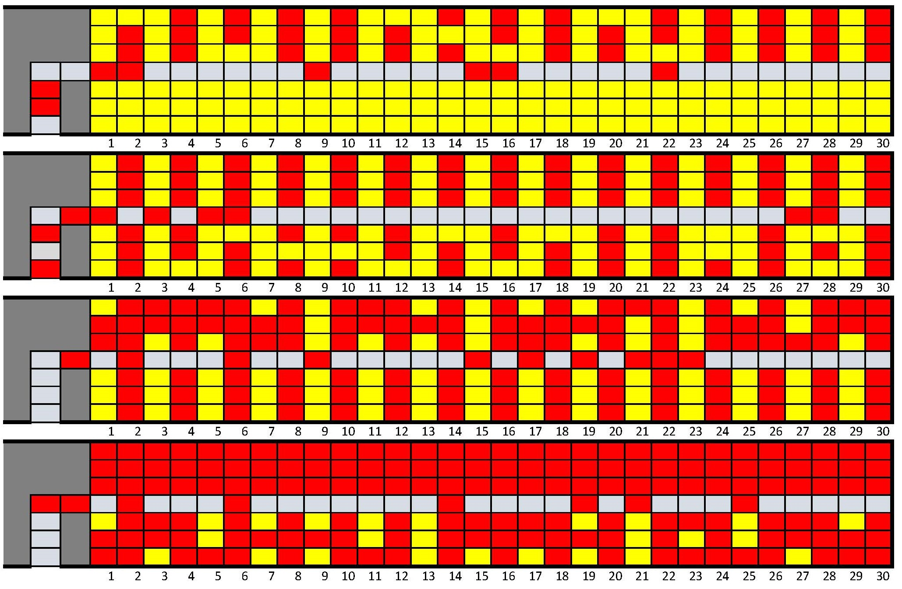
Practical optimal strategy

Slide 15
Results

Slide 17
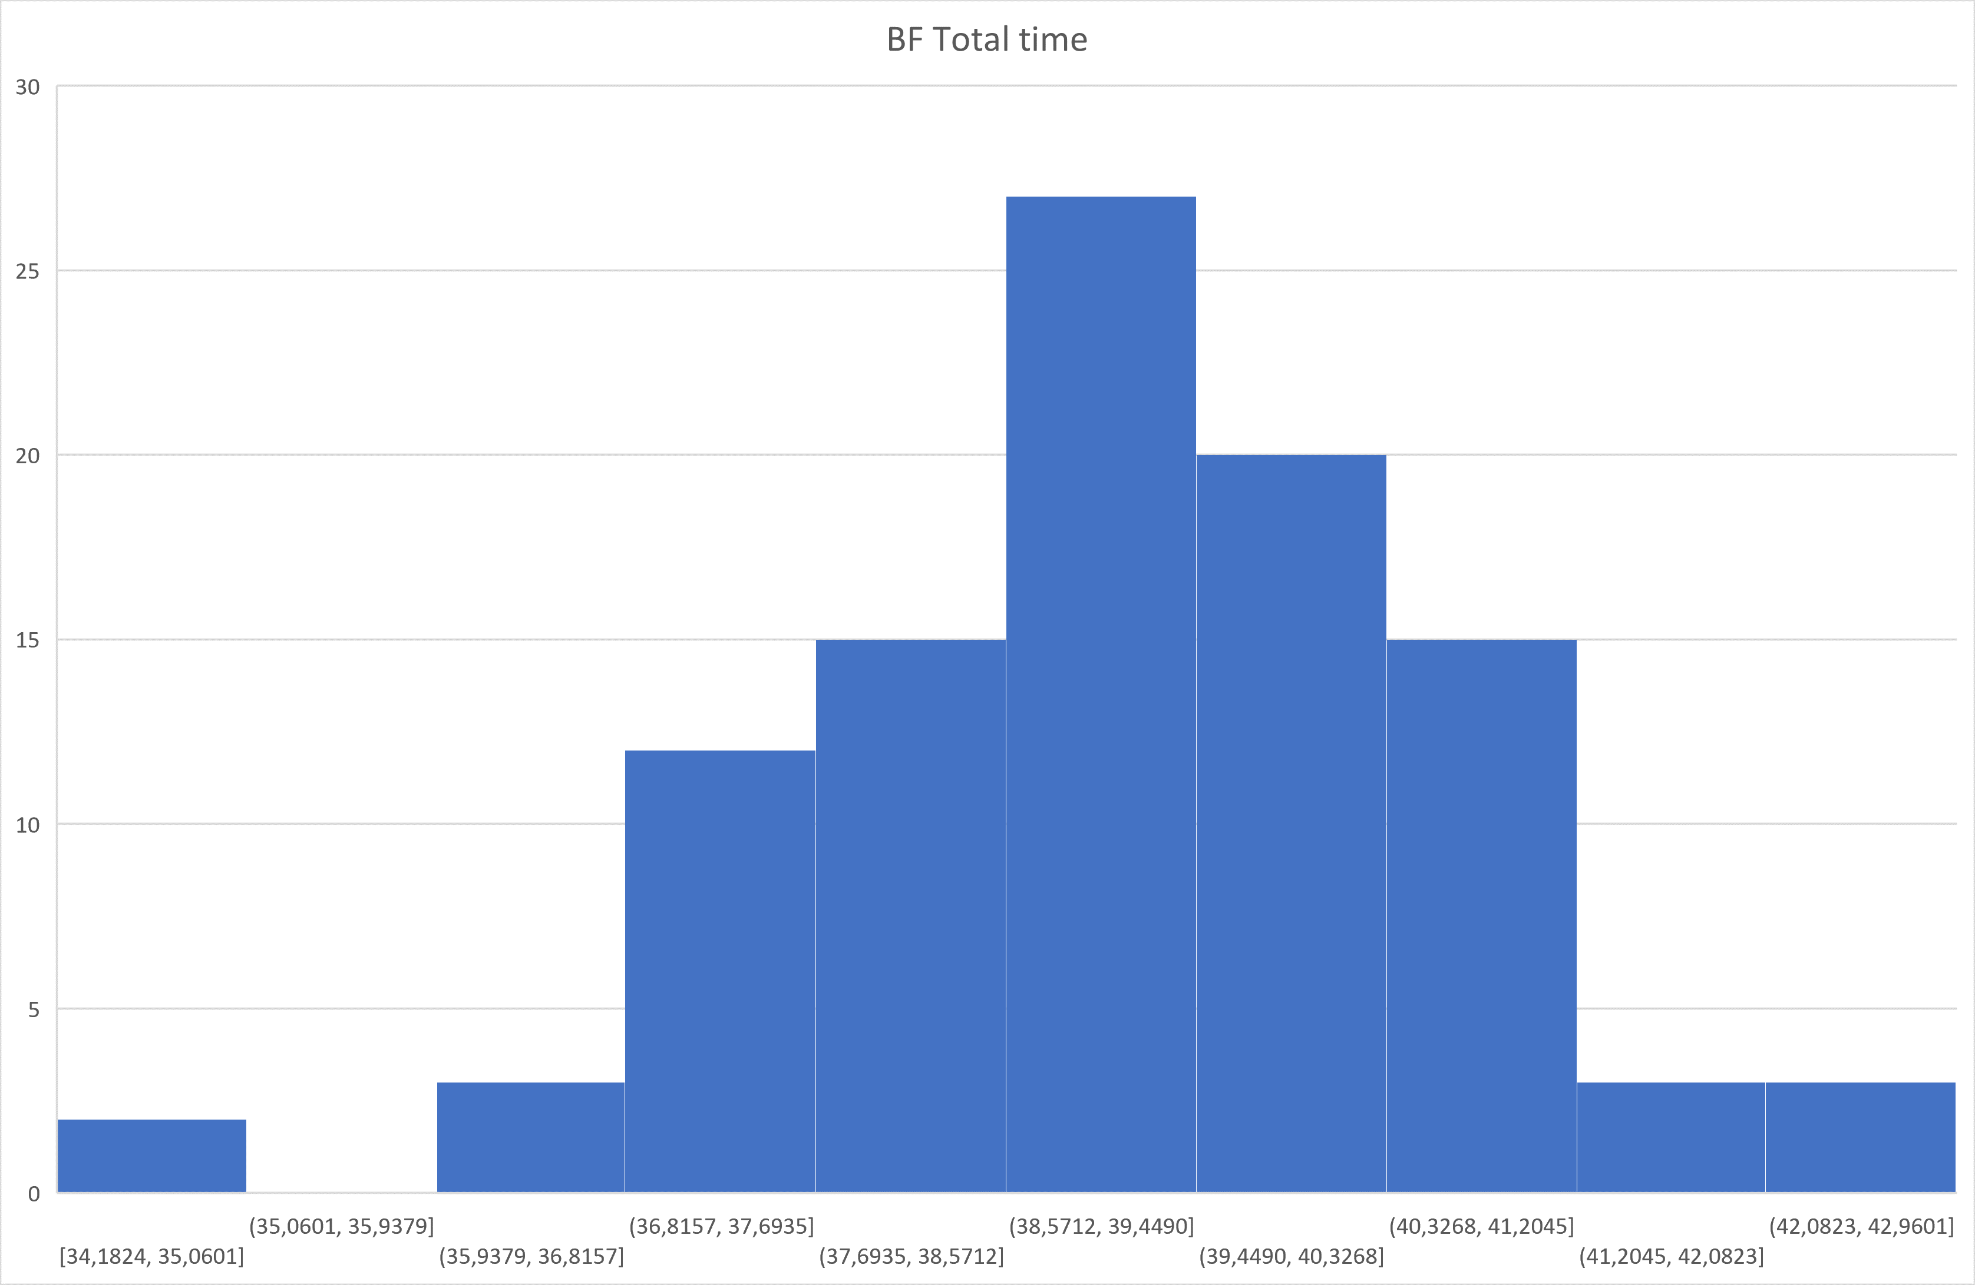

Slide 18
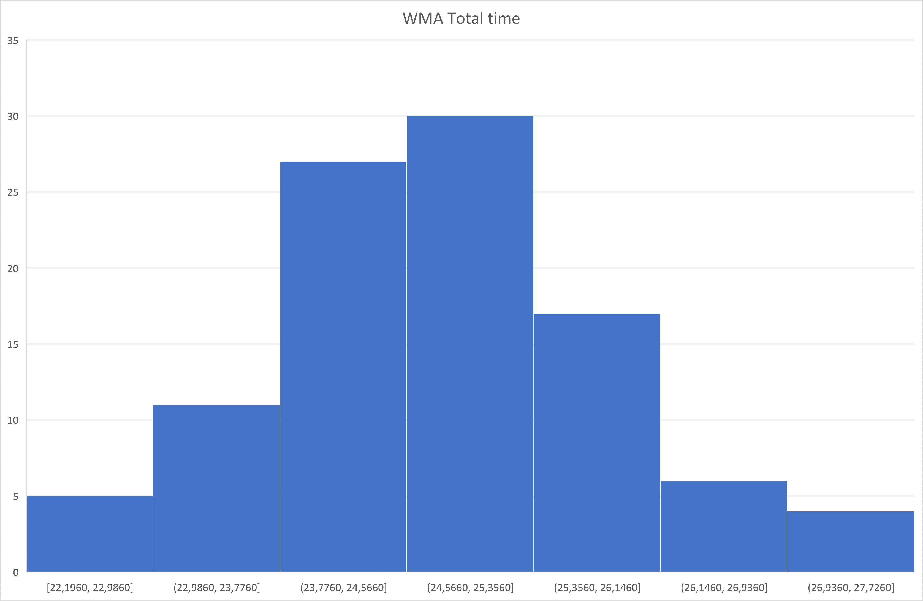

Slide 19
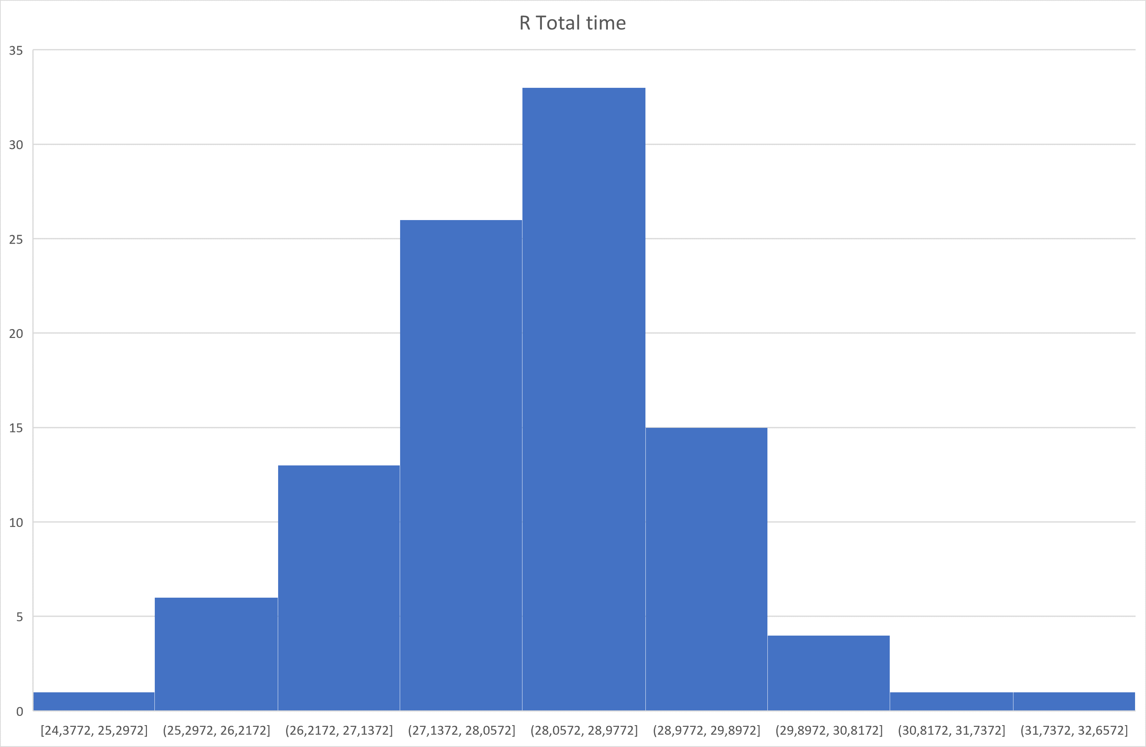

Slide 20
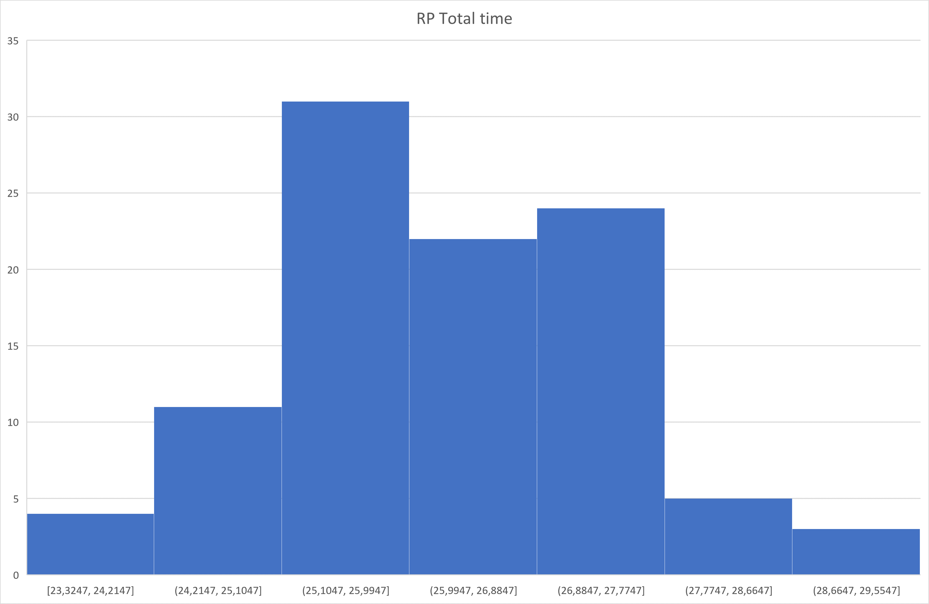

Slide 21
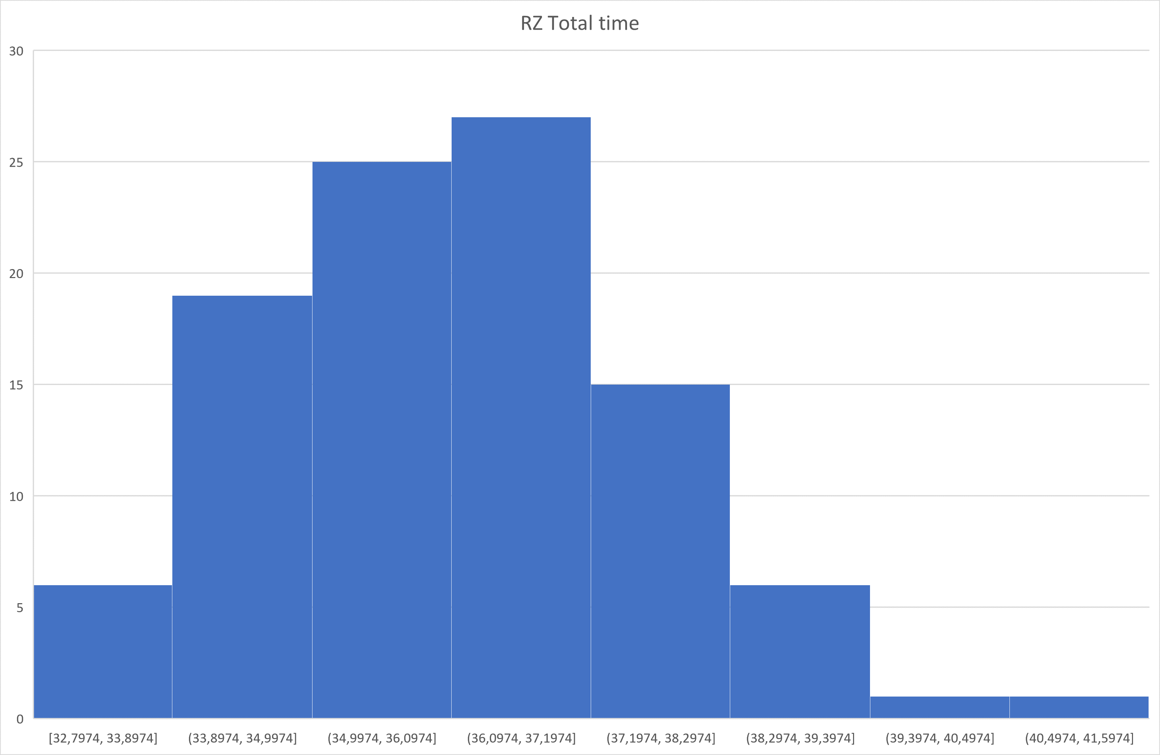

Slide 22
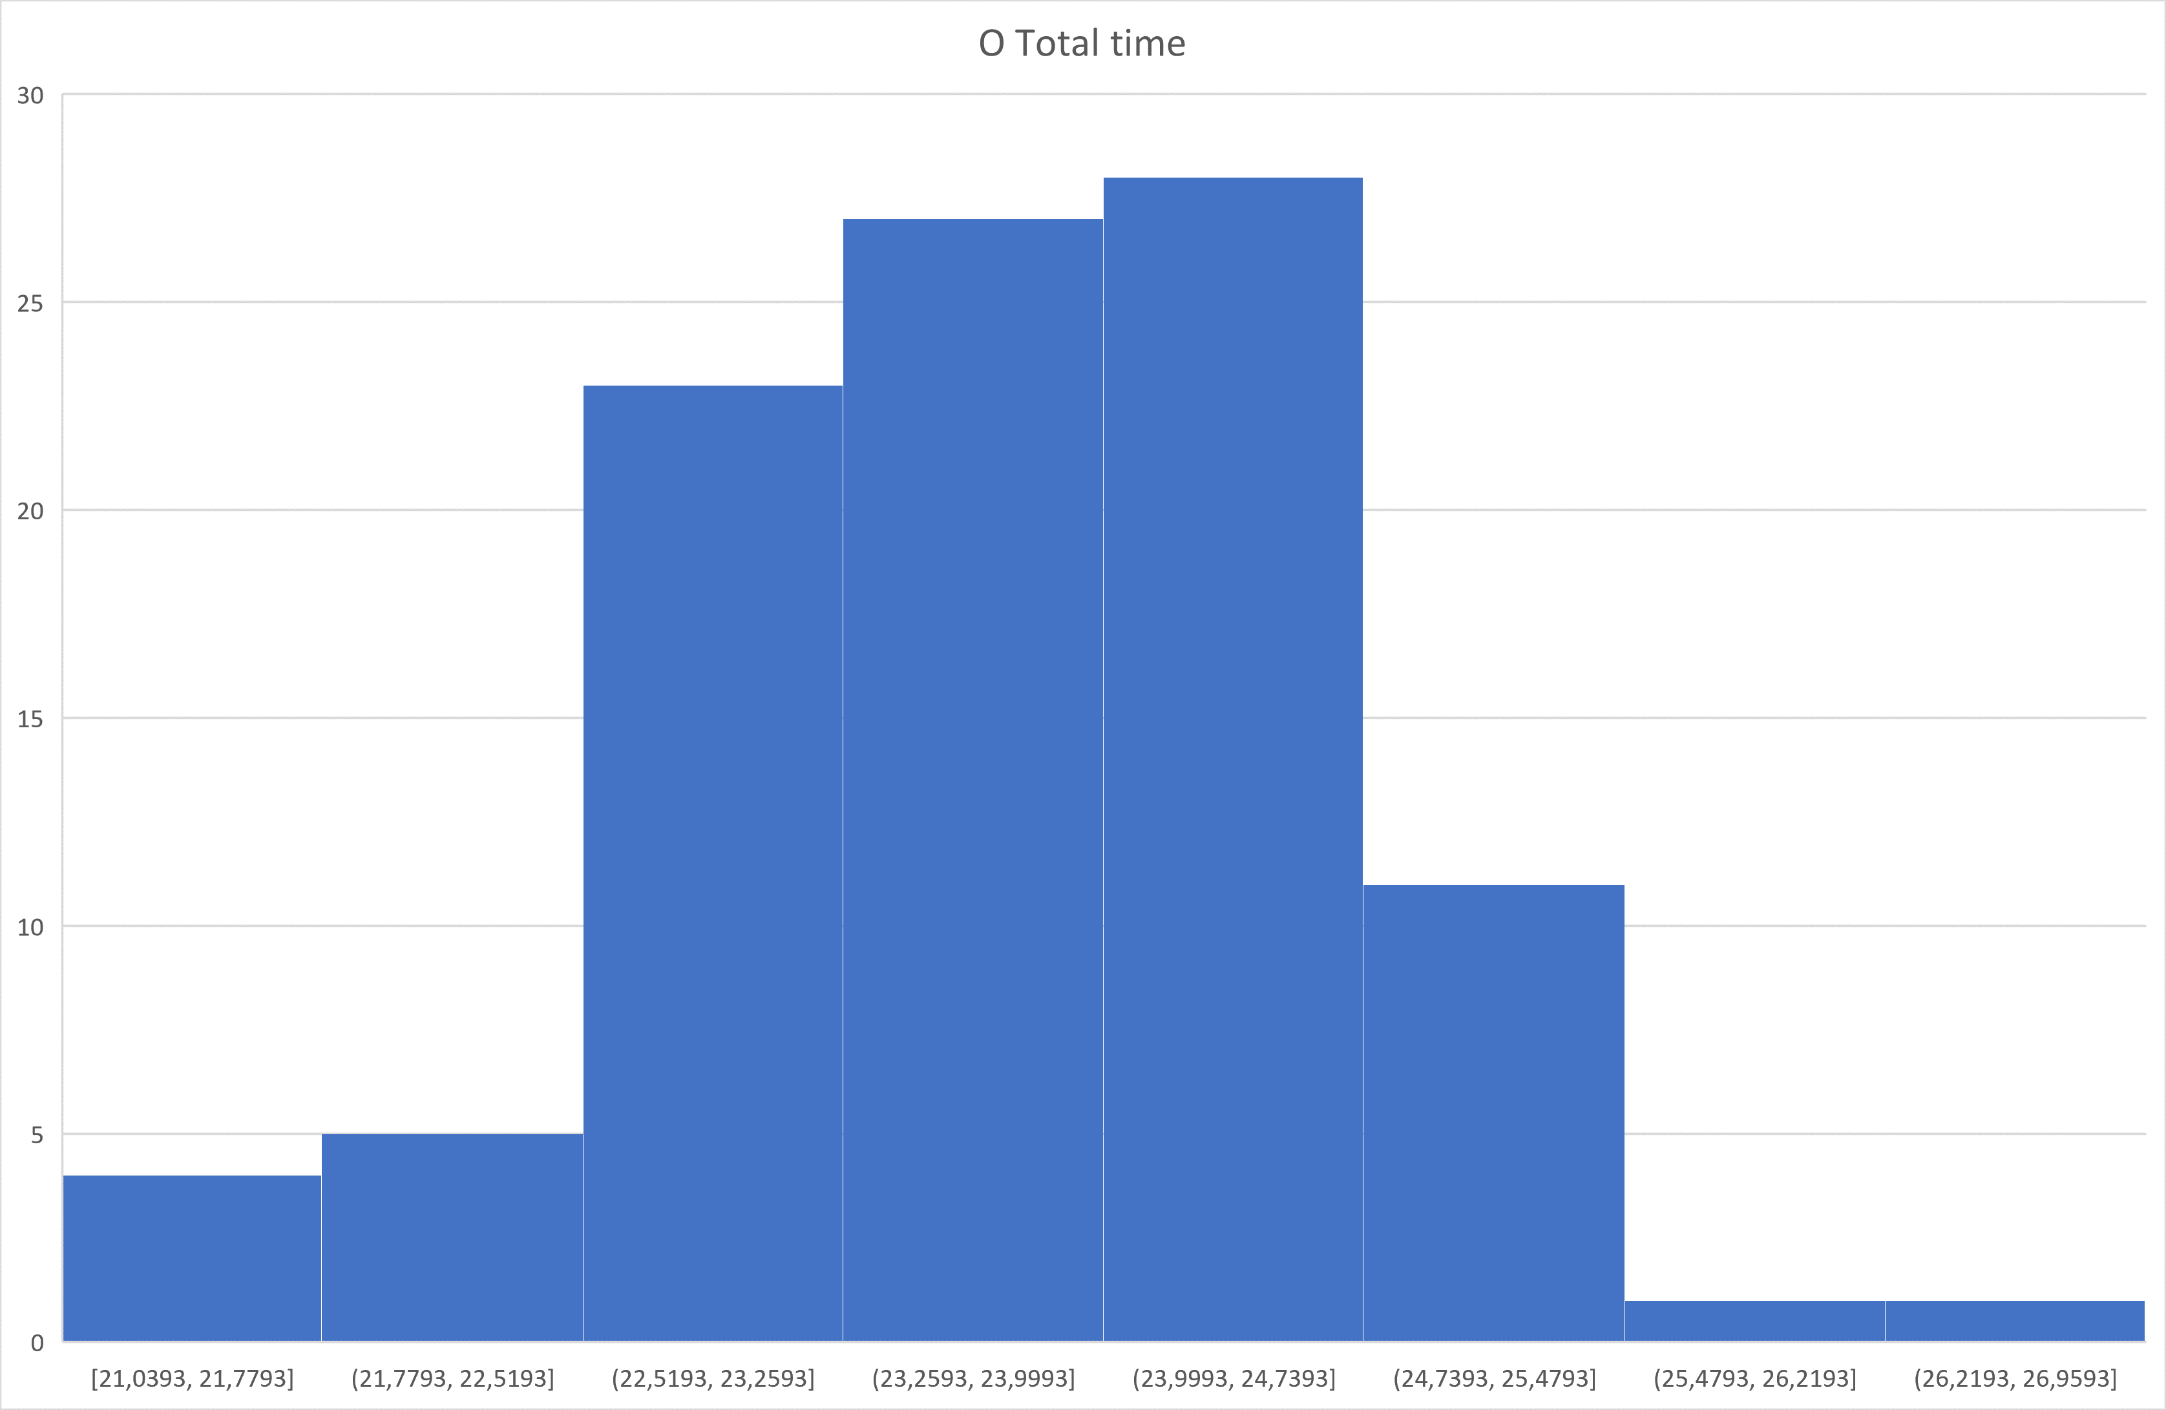

Slide 23
